Slide 1
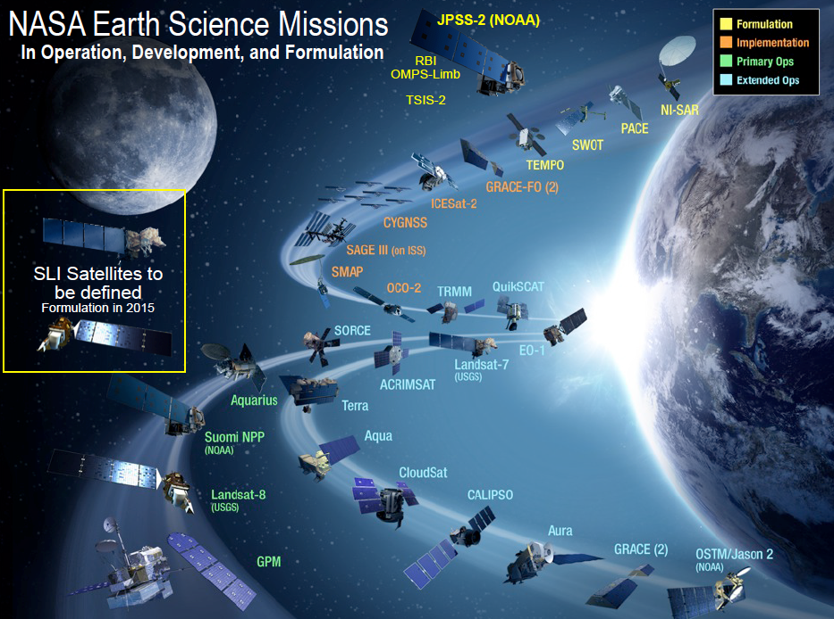
A Fiery Future: Tracking the Grass-Fire Cycle from Space Kyle Larson, Aaron Tuor
Science Questions
Can DL improve our ability to detect invasive annual grasses that are altering wildfire regimes in the West? YES!
Can we better exploit the deluge of spatiotemporal “Big Earth Data” using DL techniques? YES, although there’s still a data bottleneck
Why it matters
More efficient and sophisticated analytical techniques are needed to realize the full potential of Big Earth Data as we enter into the era of the Data Deluge
Spatiotemporal Data
6600+ field measurements through the West
53 biophysical & climatic variables
MODIS annual peak-NDVI
Landsat-7 ETM+ annual & seasonal NDVI, full spectrum
MODIS annual & seasonal EVI, partial spectrum
Developed Google Earth Engine algorithms for pre-analysis and extraction of Earth imagery
Metrics & Progress
October: Train DNN to achieve better accuracy than original LDA model using same variable set
November: Improve learning through use of complimentary NDVI and full spectrum imagery from Landsat-7 ETM+ platform
Tested DNN models with different aggregations of MODIS & Landsat data
Dec-Jan: Identify best-performing NN model and apply trained model in geographic space
Currently running experiments with CNN and RNN models
Begin working on a publication
Possible Future Work
Deploy land observation DL architectures on Google or other cloud platforms to reduce data bottleneck
Craft DL approaches for in-season monitoring of invasive annual grasses and subsequent effects on fire risk

Slide 2
RNN and CNN Models
LandSat
Full Spectrum
latitude
spectrum
Season
longitude
Time
Spectral band
CNN
DNN
Year
Flatten
image
Eco-model
Categorical embeddings
LSTM
LSTM
LSTM
LSTM
2003
2004
2010
2011
Flatten

Slide 3
Classification
Regression
P(Coverage > 2%)
% Cheatgrass Cover
Layer 3
128
Layer 2
128
Layer 1
512
LandSat
MODIS
Niche Factors

Slide 4
P(Coverage > 2%)
% Cheatgrass Cover
128
256
1024
Mean Hidden
Final Hidden
Niche Factors
Mean Hidden
Final Hidden
LandSat
LSTM
LandSat
LSTM
MODIS
LSTM
MODIS
LSTM
2003
2012
2003
2012

